Slide 1
DM and Lyot Coronagraph Optimization
Leonello

Slide 2
Defining the Lyot Coronagraph
Initial pupil plane WF (star + exoplanet)
Apply DM 1
Gaussian / 8th Order Mask in FP1
Propagate to Lyot Plane (apply Lyot Stop)
Apply DM 2
Propagate to FP 2

Slide 3
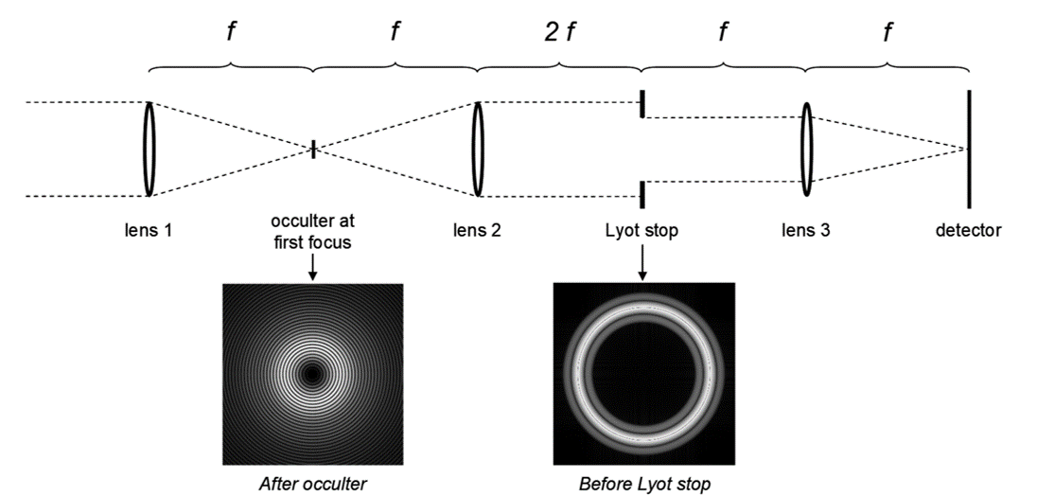
DM 1
DM 2

Slide 4
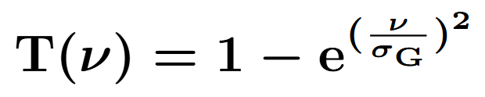
Start Parameters (No DMs / Aberrations)
Planet-To-Star Contrast = 10^-14
Planet Offset (FP): 15 lambda/D
Gaussian Width (FP): 5 lambda/D
Lyot Stop Diameter / Pupil Diameter = 0.7

Slide 5
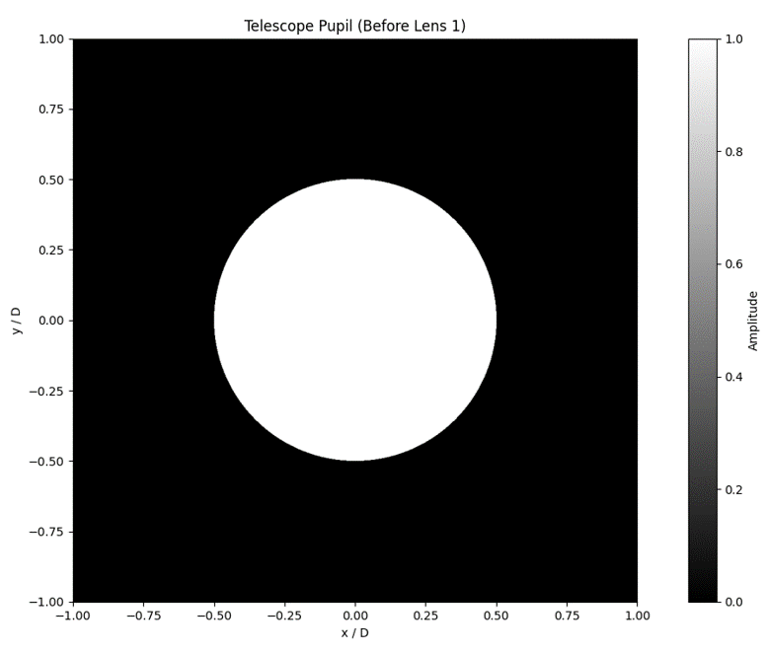

Slide 6
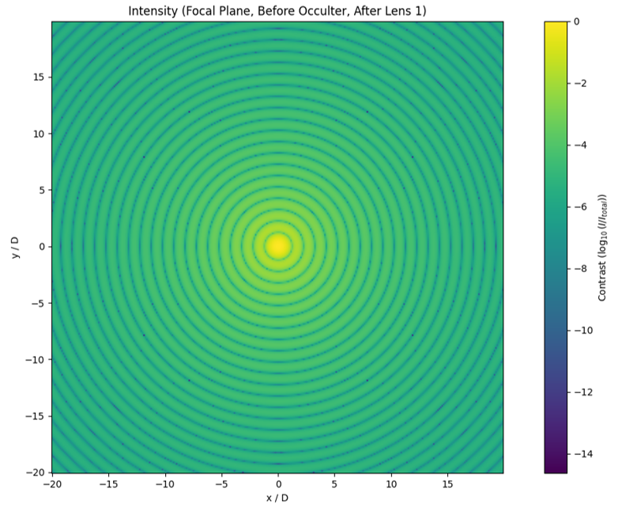

Slide 7
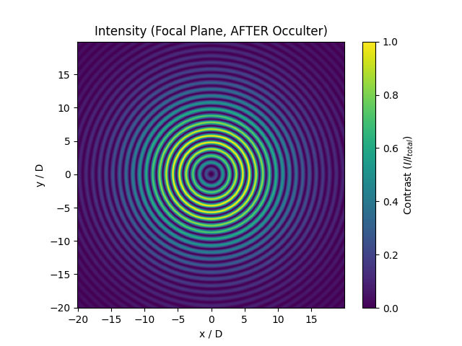

Slide 8
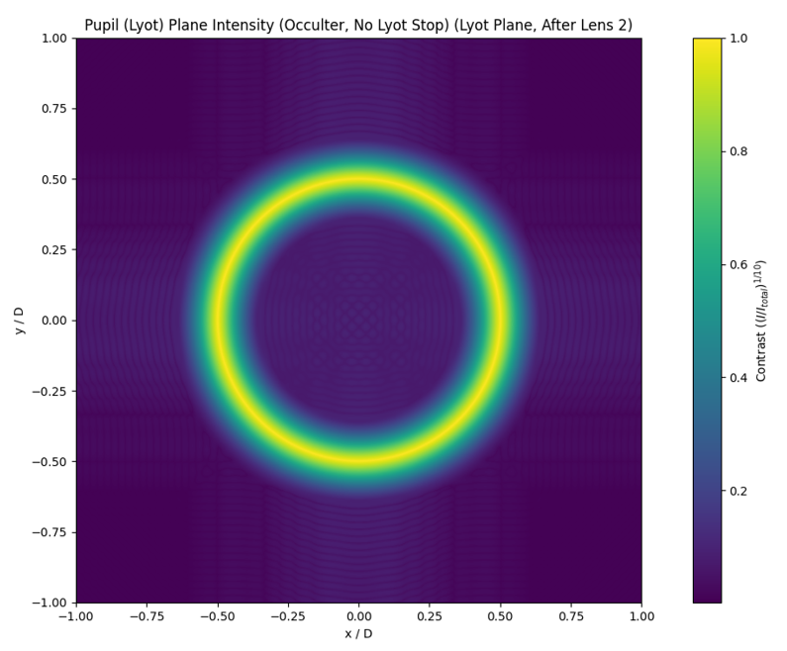

Slide 9
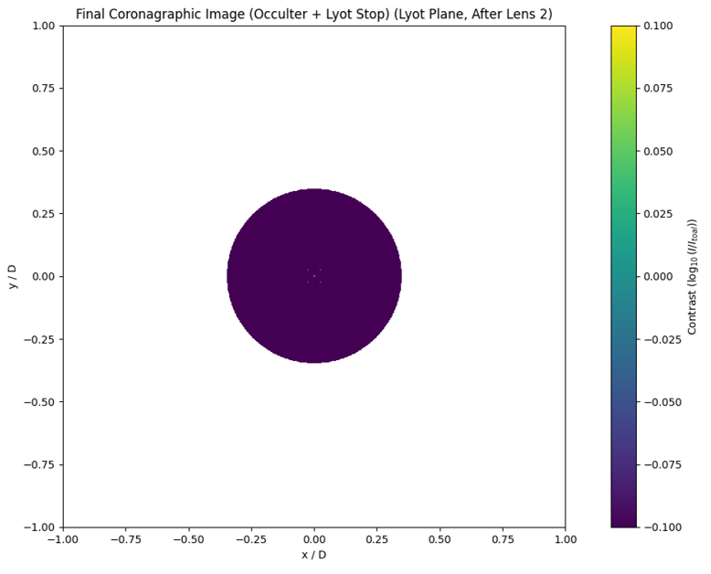

Slide 10
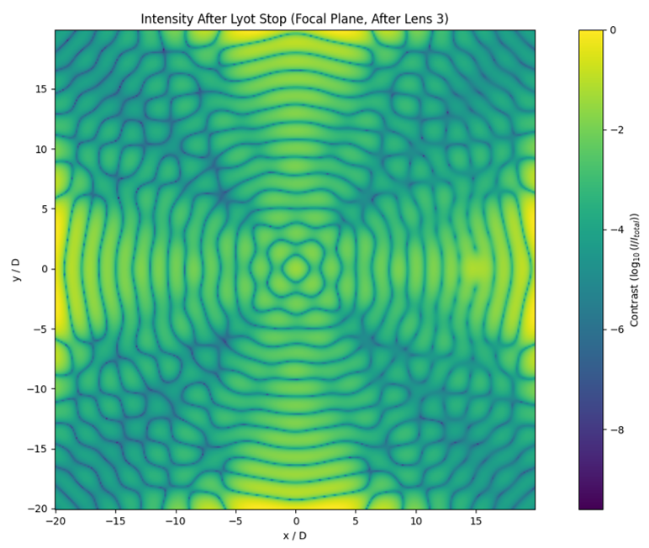

Slide 11
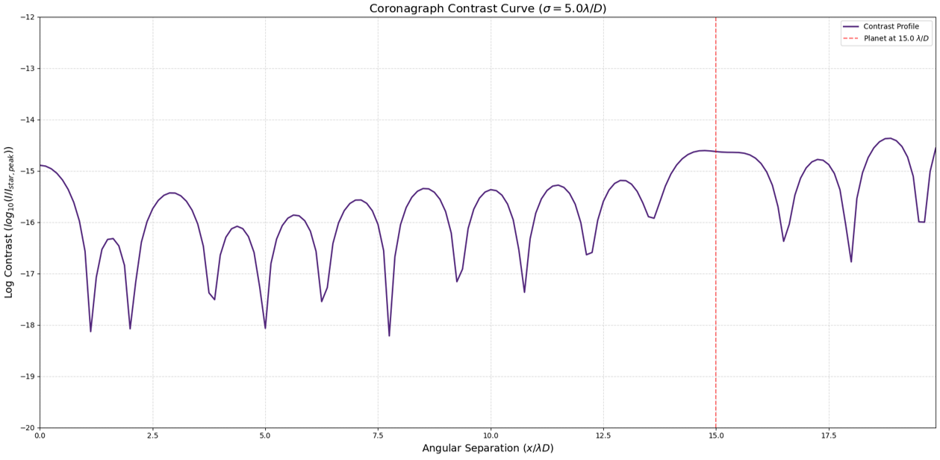

Slide 12
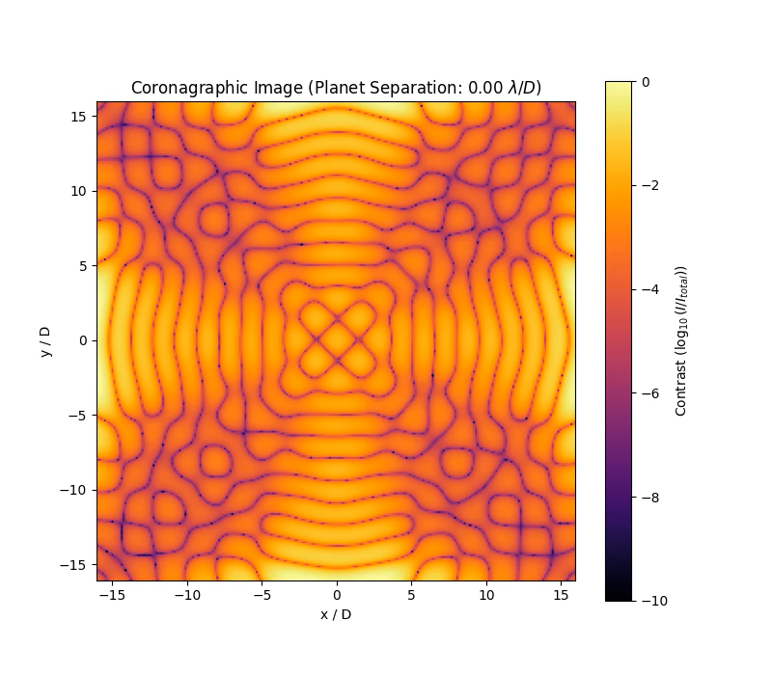

Slide 13
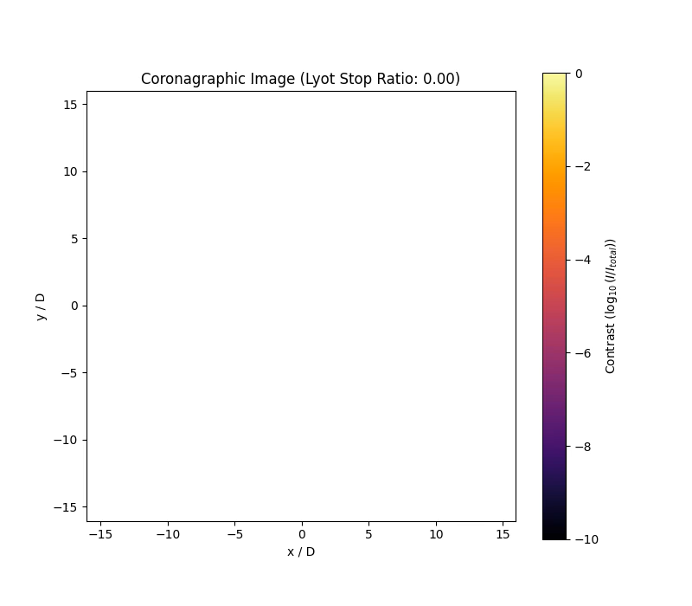

Slide 14
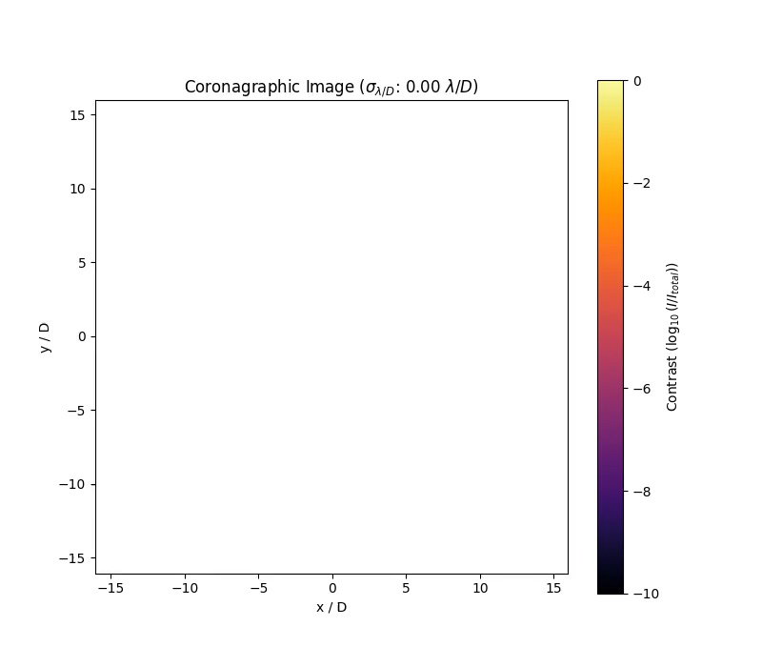

Slide 15
Introducing Aberrations and DMs
DM 1 in Pupil Plane / DM 2 in Lyot Plan
Simulation of 2 Continuous DMs and 1 HSM
Piston, Tip, Tilt (PTT) Mode Bases
DM Influence Functions (DM PTT Coefficients)
Random Zernike Basis (PTT) for incoming WF

Slide 16
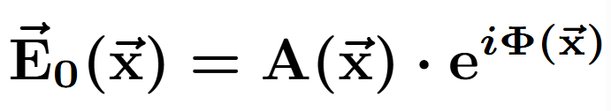
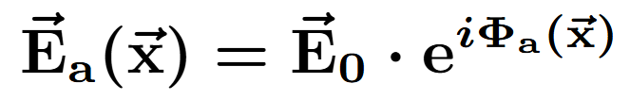
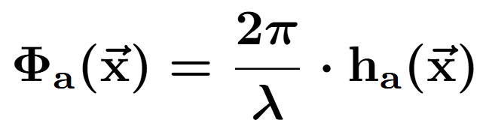

Slide 17
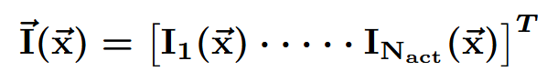
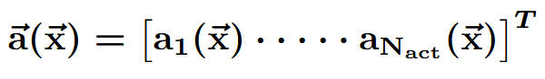
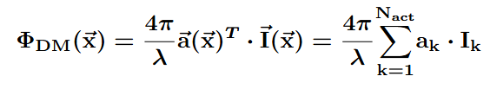
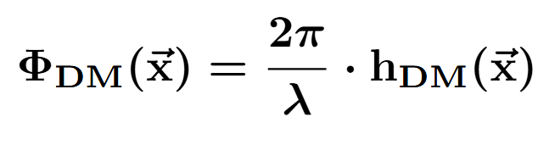
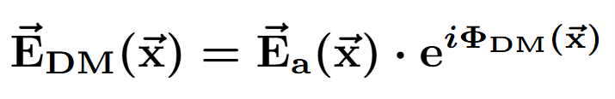
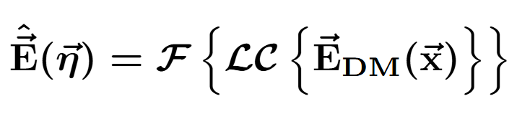

Slide 18
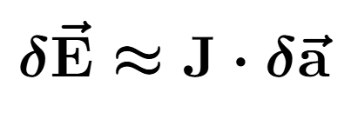
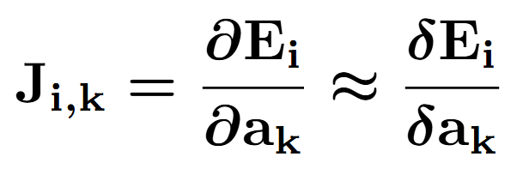

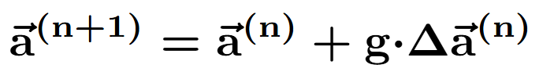

Slide 19
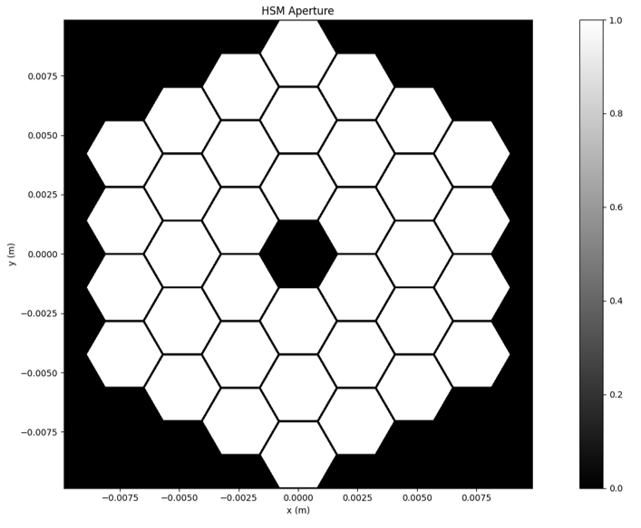
HSM in Pupil Plane

Slide 20
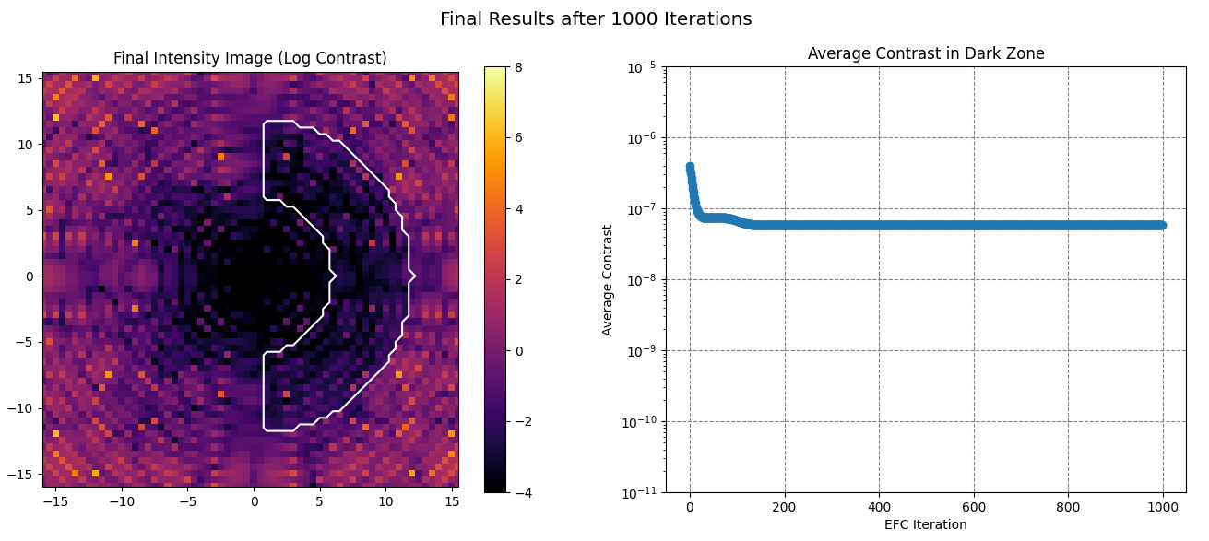
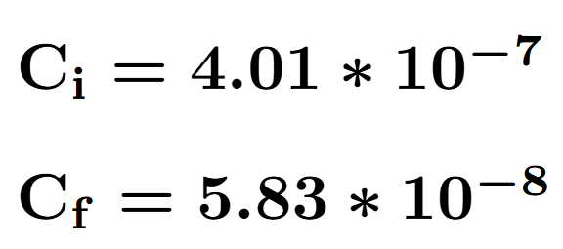

Slide 21
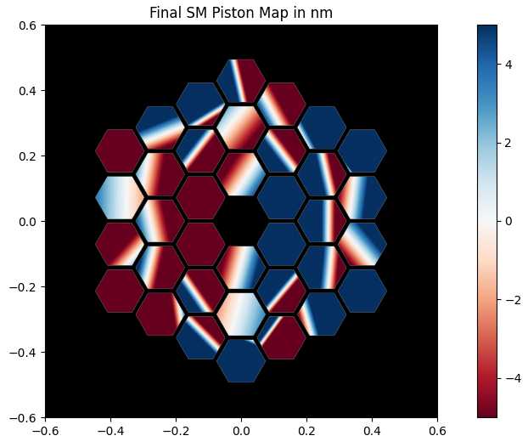

Slide 22

Continuous DM in Pupil Plane

Slide 23
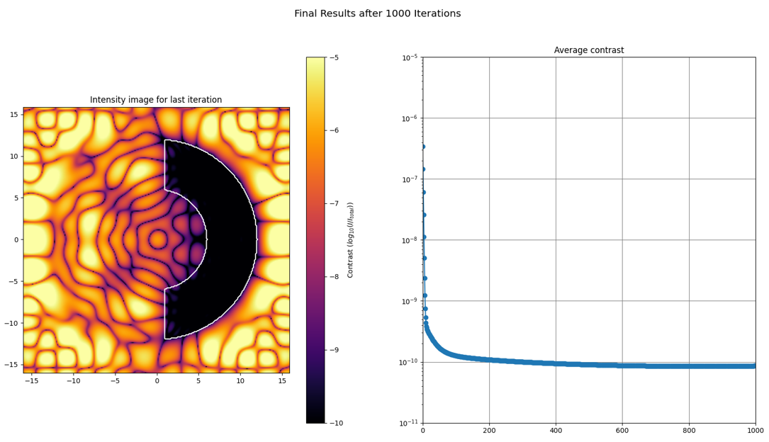
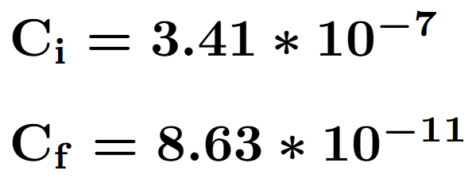

Slide 24
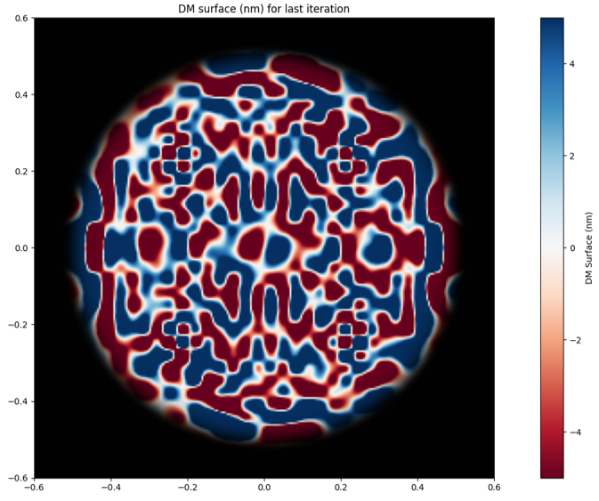

Slide 25

1 Continuous DM in Pupil Plane + 1 Continuous DM in Lyot Plane

Slide 26
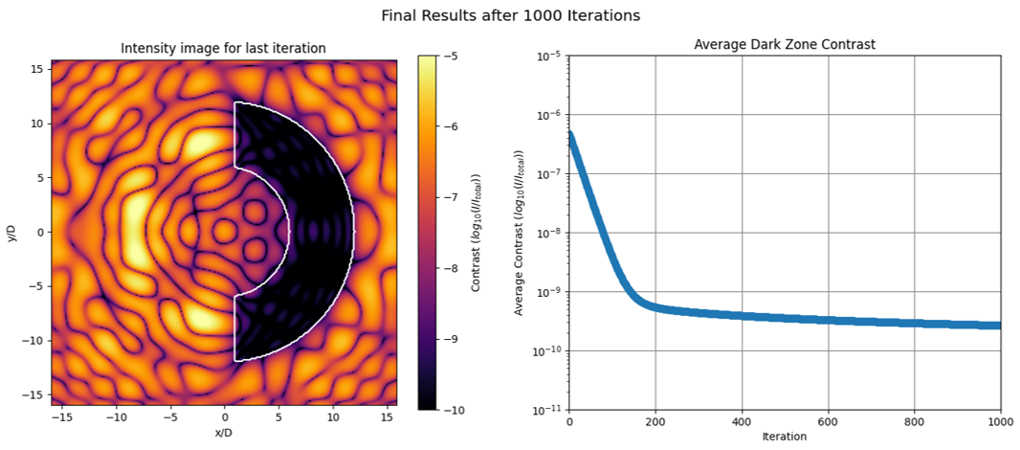
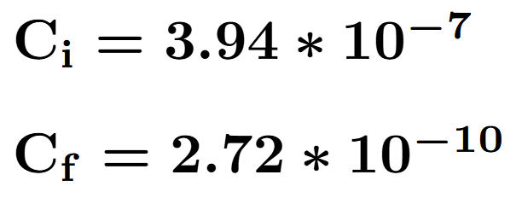

Slide 27
